Slide 1
Systems Analysis and Design CT026-3-1
Feasibility Study

Slide 2
Topic & Structure of The Lesson
Feasibility Study
Importance of feasibility study
Types of feasibility
Technical
Operational
PIECES Framework
Schedule
Economic
Cost Classification
Benefit Classification

Slide 3
Learning Outcomes
By the end of this lecture, YOU should be able to understand:
Different Types of Feasibility Study:
Schedule
Cost
Technical
Operational
-PIECES

Slide 4
Key Terms you must be able to use
If you have mastered this topic, you should be able to use the following terms correctly in your assignments and exams:
Feasibility Study
Technical feasibility
Schedule feasibility
Operational feasibility
Economic feasibility

Slide 5
The importance of feasibility study
Why is feasibility study important?
to determine whether a project has a reasonable chance of success
When are all projects feasible ?
NO tight budgetary & time constraints

Slide 6
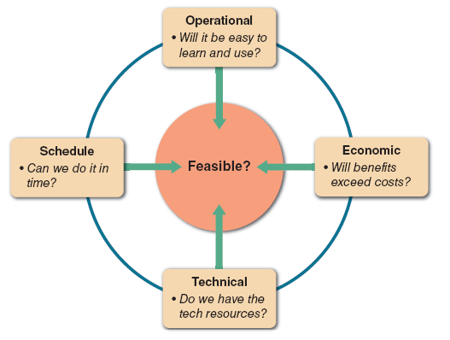
Feasibility study
FIGURE 2-14 A feasibility study examines operational, technical, economic,
and schedule factors.

Slide 7
Technical Feasibility
Process of determining whether the organization has the technology resources to develop or purchase, install, and operate the system.
Is the proposed technology or solution practical?
Do we currently possess the necessary technology?
Do we possess the necessary technical expertise, and is the schedule reasonable?
If the technology is not available, can it be acquired?

Slide 8
Operational Feasibility
The process of assessing the degree to which a proposed system solves business problems or takes advantage of business opportunities
refers to a system that users will accept and use effectively to support business objectives
The PIECES framework can help identify operational problems to be solved and their urgency

Slide 9
PIECES framework
Performance – Does the current mode of operation provide adequate throughput and response time?
Information – Does the current mode provide end users and managers with timely, pertinent, accurate and usefully formatted information?
Economy – Does the current mode of operation provide cost-effective information services to the business? Could there be a reduction in costs and / or an increase in benefits?

Slide 10
PIECES framework
Control – Does current mode of operation offer effective controls to protect against fraud and to guarantee accuracy and security of data and information?
Efficiency – Does the current mode of operation make maximum use of available resources, including people, time, flow of forms?
Services – Does the current mode of operation provide reliable service? Is it flexible and expandable?

Slide 11
Schedule Feasibility
The process of assessing the degree to which the potential time frame and completion dates for all major activities within a project meet organizational deadlines and constraints for affecting change.

Slide 12
Summary of Main Teaching Points
Feasibility Study
Importance of feasibility study
Types of feasibility
Technical
Operational
PIECES Framework
Schedule

Slide 13
After the break
Feasibility Study
Types of feasibility
Economic
Cost Classification
Benefit Classification

Slide 14
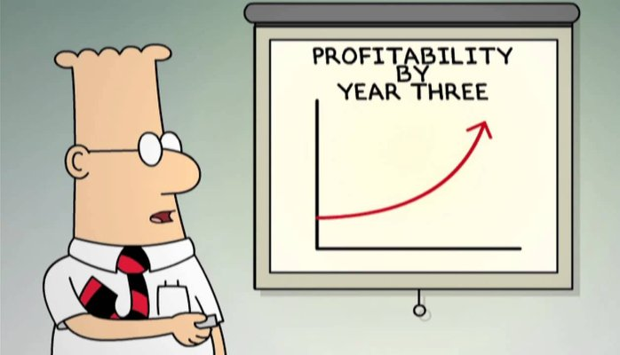
Learning Outcomes
By the end of this lecture, YOU should be able to :
Identify the cost classification

Slide 15
Economic feasibility
consists of 2 tests :
Is the anticipated value of the benefits greater than projected costs of development? (cost / benefit analysis)
Does the organisation have adequate cash flow to fund the project during the development period?

Slide 16
Economic feasibility
cost-benefit analysis
process of identifying the financial benefits and costs associated with a development project
is performed when
Conducting a preliminary investigation
Evaluating a project
Making recommendations to management

Slide 17
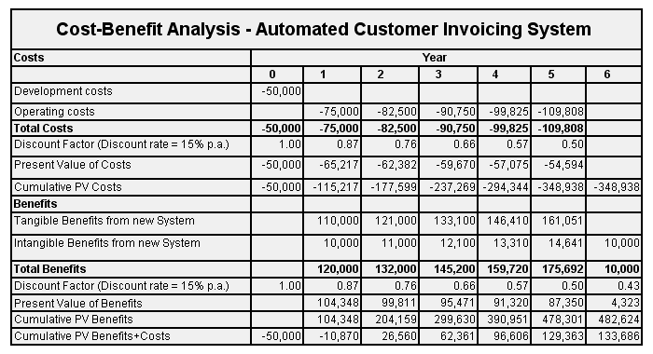

Slide 18
Cost Classifications
Tangible / Intangible costs
tangible costs :
costs for which you can assign a specific dollar value
Example :
employee salaries
hardware and software purchases
office supplies

Slide 19
Cost Classifications
Tangible / Intangible costs
intangible costs :
costs whose dollar value cannot be calculated easily
Example :
customer dissatisfaction
lowered employee morale
reduced information availability

Slide 20
Cost Classifications
Direct / Indirect costs
Direct costs
costs that can be associated with the development of a specific system
Example :
salaries of project team members
purchase of hardware

Slide 21
Cost Classifications
Direct / Indirect costs
Indirect costs
overhead expenses / costs that cannot be attributed to the development of a specific system
Example :
salaries of network administrators
copy machine rentals
insurance expenses

Slide 22
Cost Classifications
Fixed / Variable costs
Fixed costs
costs that are relatively constant and do not depend on a level of activity or effort
Example :
salaries
hardware rentals

Slide 23
Cost Classifications
Fixed / Variable costs
Variable costs
costs that vary depending on the level of activity
Example :
printer paper
supplies
telephone line charges

Slide 24
Cost Classifications
Developmental / Operational costs
Developmental costs
costs that are incurred only once at the time the system is developed or acquired
Example :
salaries of people involved in system
development
software purchases
initial user training
purchase of necessary hardware or furniture

Slide 25
Cost Classifications
Developmental / Operational costs
Operational costs
costs that are incurred after the system is implemented and continue while system is in use
Example :
system maintenance
ongoing training
annual software license fee
communications expenses

Slide 26
Cost Classifications
Some costs apply to more than one category of expenses
Overtime pay for clerical staff during the systems analysis phase would be classified as developmental, variable, and direct
A monthly fee for maintaining the company’s Web site would be regarded as operational, fixed, and indirect
Managing Information Systems Costs and Charges
Direct costs usually are easier to identify and predict than indirect costs

Slide 27
Benefit Classifications
Benefit Classifications
Like costs, benefits can be classified as tangible or intangible, fixed or variable, and direct or indirect
Positive benefits increase revenues, improve services, or otherwise contribute to the organization as a direct result of the new information system
Cost-avoidance benefits refer to expenses that would be necessary if the new system were not installed

Slide 28
Benefit Classifications
Benefits can be classified as :
Tangible / Intangible benefits
Direct / Indirect benefits
Fixed / Variable benefits
Developmental / Operational benefits
Another useful benefit classification relates to the nature of the benefit :
Positive / Cost-avoidance benefits

Slide 29
Benefit Classifications
Positive / Cost-avoidance benefits
Positive benefits
Benefits that are a direct result of the new information system
Example :
Increased revenues
Improved services
Higher morale
Better management

Slide 30
Benefit classifications
Positive / Cost-avoidance benefits
Cost avoidance benefits
Expenses that would be necessary if the new system is not installed
Example :
Handling work with current staff instead of hiring
Not having to replace hardware and software

Slide 31
Quick Review Question
List 4 main feasibility?
Describe what is involved in economic feasibility?
What PICES stands for?

Slide 32
Summary of Main Teaching Points
Feasibility Study
Types of feasibility
Economic
Cost Classification
Benefit Classification

Slide 33
Question and Answer Session
Q & A

Slide 34
What we will cover next
System Analysis – Logical Modelling

